Slide 1
Introducing deep learning and the
PyTorch Library
张乐
2020年７月14日

Slide 2
Part 1:
  In chapter 1, we’ll make our first contact with PyTorch, understand what it is and what problems it solves, and how it relates to other deep learning frameworks.
  Chapter 2 will take us on a tour, giving us a chance to play with models that have been pretrained on fun tasks.
  Chapter 3 gets a bit more serious and teaches the basic data structure used in PyTorch programs: the tensor.
  Chapter 4 will take us on another tour, this time across ways to represent data from different domains as PyTorch tensors.

Slide 3
Part 1:
  Chapter 5 unveils how a program can learn from examples and how PyTorch supports this process.
  Chapter 6 provides the fundamentals of what a neural network is and how to build a neural network with PyTorch.
  Chapter 7 tackles a simple image classification problem with a neural network architecture.
  Chapter 8 shows how the same problem can be cracked in a much smarter way using a convolutional neural network.
  By the end of part 1, we’ll have what it takes to tackle a real-world problem with PyTorch in part 2.

Slide 4
本章框架
Introducing deep learning and the PyTorch Library 3
  1.1 The deep learning revolution 4
  1.2 PyTorch for deep learning 6
  1.3 Why PyTorch? 7
    The deep learning competitive landscape 8
  1.4 An overview of how PyTorch supports deep learning projects 10
  1.5 Hardware and software requirements 13
    Using Jupyter Notebooks 14
  1.6 Exercises 15
  1.7 Summary 15

Slide 5
章节前言
人工智能：able to approximate complicated, nonlinear processes very, very effectively, which we can use to automate tasks that were previously limited to humans.
深度学习：That general class of algorithms we’re talking about falls under the AI subcategory of deep learning, which deals with training mathematical entities named deep neural networks by presenting instructive examples.
Deep learning uses large amounts of data to approximate complex functions whose inputs and outputs are far apart, like an input image and, as output, a line of text describing the input.

Slide 6
1.1 The deep learning revolution
标题含义：paradigm shift ushered in by this deep learning approach
介绍方法：历史→Deep learning
历史：Until the last decade, the broader class of systems that fell under the label machine learning relied heavily on feature engineering. Features are transformations on input data that facilitate a downstream algorithm.

Slide 7
1.1 The deep learning revolution
标题含义：paradigm shift ushered in by this deep learning approach
介绍方法：历史→Deep learning
Deep learning:
Deep learning, deals with finding such representations automatically, from raw data, in order to successfully perform a task.
the ability of a neural network to ingest data and extract useful representations on the basis of examples is what makes deep learning so powerful.
The focus of deep learning practitioners is on operating on a mathematical entity so that it discovers representations from the training data autonomously.
Often, these automatically created features are better than those that are handcrafted!

Slide 8
1.2 PyTorch for deep learning
介绍方法：pytorch的优点→本书的书写理念→介绍本书的三部分
pytorch的优点：
  pytorch emphasizes flexibility.
  As Python does for programming, PyTorch provides an excellent introduction to deep learning.
  PyTorch has been proven to be fully qualified for use in professional contexts for real-world, high-profile work.
  PyTorch’s clear syntax, streamlined API, and easy debugging make it an excellent choice for introducing deep learning.

Slide 9
1.2 PyTorch for deep learning
介绍方法：pytorch的优点→本书的书写理念→介绍本书的三部分
本书的书写理念：
  a starting point for software engineers, data scientists, and motivated students fluent in Python.
  We want this book to be as accessible and useful as possible.
  we use a hands-on approach and encourage you to keep your computer at the ready.

Slide 10
1.2 PyTorch for deep learning
介绍方法：pytorch的优点→本书的书写理念→介绍本书的三部分
介绍本书的三部分：
  Part 1 covers the foundations, examining in detail the facilities PyTorch offers to put the sketch of deep learning into action with code.
  Part 2 walks you through an end-to-end project involving medical imaging: finding and classifying tumors in CT scans, building on the basic concepts introduced in part 1, and adding more advanced topics.
  part 3 rounds off the book with a tour of what PyTorch offers for deploying deep learning models to production.

Slide 11
1.3 Why PyTorch?
Reasons1-2 :
PyTorch gives us a data type, the Tensor, to hold numbers, vectors, matrices, or arrays in general. We can program with them interactively.
PyTorch has also grown bindings to other languages and an interface for deploying to mobile devices.

Slide 12
1.3 Why PyTorch?
Reasons3-4 :
A design driver for PyTorch is expressivity ,PyTorch offers one of the most seamless translations of ideas into Python code in the deep learning landscape.
At the International Conference on Learning Representations (ICLR) 2019, PyTorch appeared as a citation in 252 papers, up from 87 the previous year and at the same level as TensorFlow, which appeared in 266 papers.

Slide 13
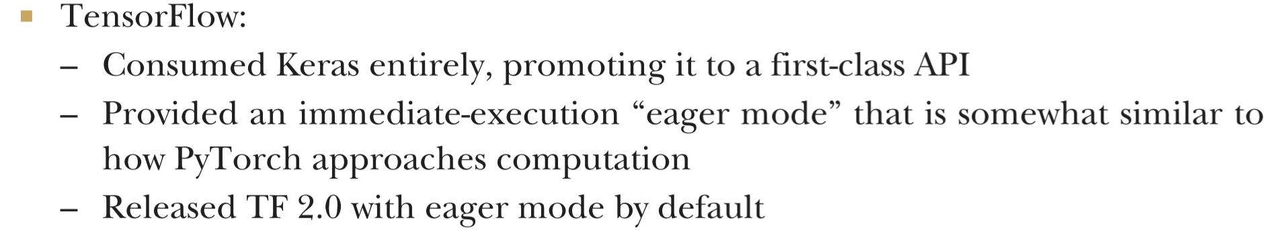
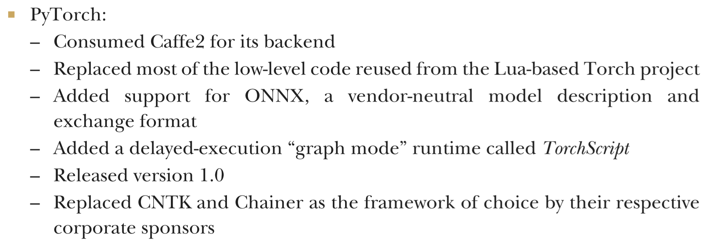
1.3.1 The deep learning competitive landscape
标题:比较各个深度学习库

Slide 14
1.3.1 The deep learning competitive landscape
TensorFlow has a robust pipeline to production, an extensive industry-wide community, and massive mindshare.
PyTorch has made huge inroads with the research and teaching communities, thanks to its ease of use , as researchers and graduates train students and move to industry. It has also built up steam in terms of production solutions.

Slide 15
1.4 An overview of how PyTorch supports deep learning projects
标题:pytorch是如何支持深度学习的
介绍方法：底层模块→构建神经网络模块
底层模块：
most of PyTorch is written in C++ and CUDA that can be compiled to run with massive parallelism on GPUs.
provides multidimensional arrays, or tensors (details on those in chapter 3) and an extensive library of operations on them, provided by the torch module. Both tensors and the operations on them can be used on the CPU or the GPU.
PyTorch provides is the ability of tensors to keep track of the operations performed on them and to compute derivatives of an output of a computation with respect to any of its inputs.

Slide 16
1.4 An overview of how PyTorch supports deep learning projects
标题:pytorch是如何支持深度学习的
介绍流程：底层模块→构建神经网络模块→模型训练流程
构建神经网络模块：
The core PyTorch modules for building neural networks are located in torch.nn, which provides common neural network layers and other architectural components.
Fully connected layers, convolutional layers, activation functions, and loss functions can all be found here (more detail about what all that means as we go through the rest of this book)

Slide 17
1.4 An overview of how PyTorch supports deep learning projects
介绍流程：底层模块→构建神经网络模块→模型训练流程
模型训练流程：
数据转换→数据读取→模型训练
数据转换：
we need to convert each sample from our data into a something PyTorch can actually handle: tensors. This bridge between our custom data and a standardized PyTorch tensor is the Dataset class PyTorch provides in torch.utils.data.
We will look in detail at how to represent various type of data we might want to work with as tensors in chapter 4.

Slide 18
1.4 An overview of how PyTorch supports deep learning projects
介绍流程：底层模块→构建神经网络模块→模型训练流程
模型训练流程：
数据转换→数据读取→模型训练
数据读取：
we will need multiple processes to load our data, in order to assemble them into batches: tensors that encompass several samples.
PyTorch readily provides all that magic in the DataLoader class. Its instances can spawn child processes to load data from a dataset in the background so that it’s ready and waiting for the training loop as soon as the loop can use it. We will meet and use Dataset and DataLoader in chapter 7.

Slide 19
1.4 An overview of how PyTorch supports deep learning projects
介绍流程：底层模块→构建神经网络模块→模型训练流程
模型训练流程：
数据转换→数据读取→模型训练
模型训练：
We then compare the outputs of our model to the desired output (the targets) using some criterion or loss function. Just as it offers the components from which to build our model, PyTorch also has a variety of loss functions at our disposal. They, too, are provided in torch.nn.
we also need an optimizer doing the updates, and that is what PyTorch offers us in torch.optim. We will start looking at training loops with loss functions and optimizers in chapter 5 and then hone our skills in chapters 6 through 8

Slide 20
1.4 An overview of how PyTorch supports deep learning projects
介绍流程：底层模块→构建神经网络模块→模型训练流程
模型训练流程：
数据转换→数据读取→模型训练→模型部署
模型部署：
PyTorch also provides a way to compile models ahead of time through TorchScript. Using TorchScript, PyTorch can serialize a model into a set of instructions that can be invoked independently from Python: say, from C++ programs or on mobile devices. We can think about it as a virtual machine with a limited instruction set, specific to tensor.
TorchScript or in a standardized format called ONNX are the basis of the production deployment capabilities of PyTorch. We’ll cover this in chapter 15.

Slide 21
1.5 Hardware and software requirements
介绍流程：cuda-GPU→hard disk
硬件需求：
You can follow along with everything we do in part 1 of this book using a standard personal computer or laptop.
However, we anticipate that completing a full training run for the more advanced examples in part 2 will require a CUDA-capable GPU. The default parameters used in part 2 assume a GPU with 8 GB of RAM (we suggest an NVIDIA GTX 1070 or better)
running on a GPU cuts training time by at least an order of magnitude (and usually it’s 40–50x faster)
Preferably you will have space on a local SSD to store the data for fast retrieval.

Slide 22
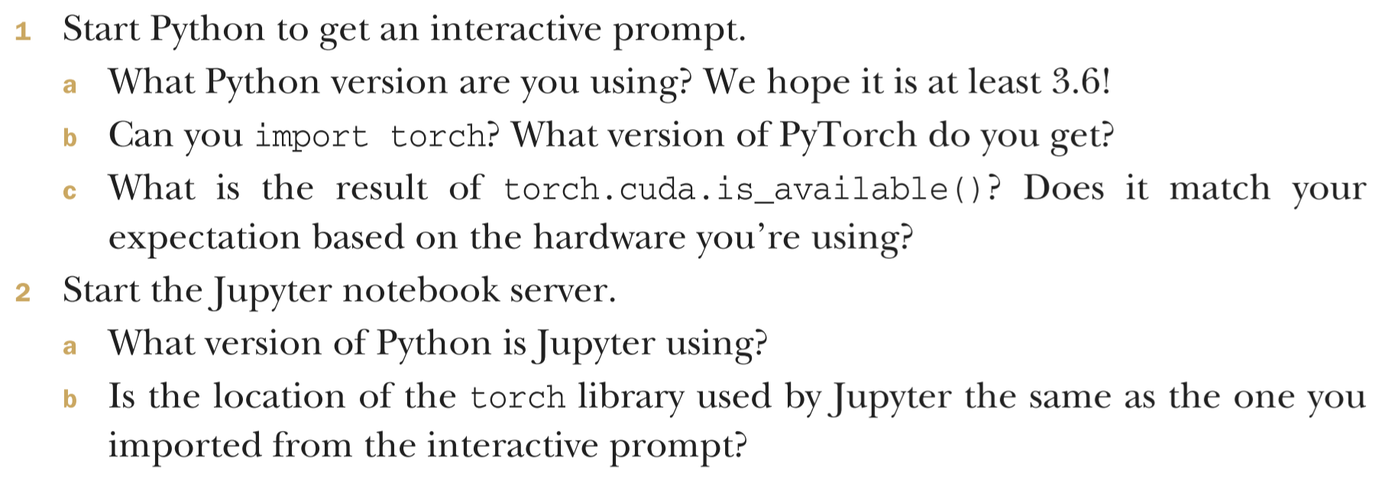
1.6 Exercises

Slide 23
1.7 Summary
Deep learning models automatically learn to associate inputs and desired outputs from examples.
PyTorch allow you to build and train neural network models efficiently.
PyTorch minimizes cognitive overhead while focusing on flexibility and speed. It also defaults to immediate execution for operations.
TorchScript allows us to precompile models and invoke them not only from Python but also from C++ programs and on mobile devices.
PyTorch provides a number of utility libraries to facilitate deep learning projects.

